Slide 1
Python Libraries
By Ahsan Ijaz

Slide 2

NumPy
NumPy (Numerical Python) is a Python library used for working with arrays. It also has functions for working in domain of linear algebra, fourier transform, and matrices. NumPy was created in 2005 by Travis Oliphant
POWERFUL N-DIMENSIONAL ARRAYS
NUMERICAL COMPUTING TOOLS
INTEROPERABLE
PERFORMANT
EASY TO USE
OPEN SOURCE
Notes:
https://numpy.org/

Slide 3
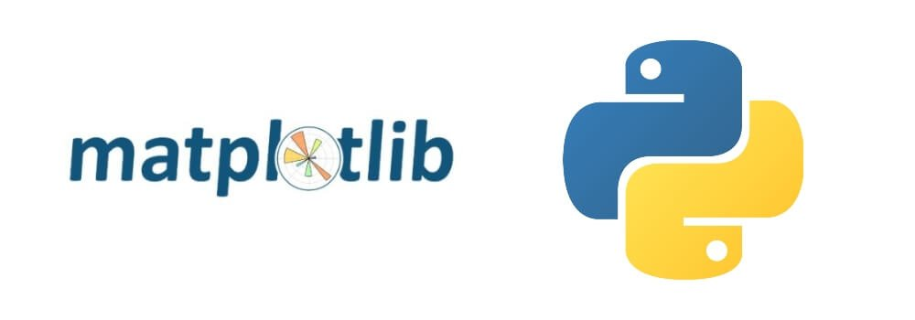
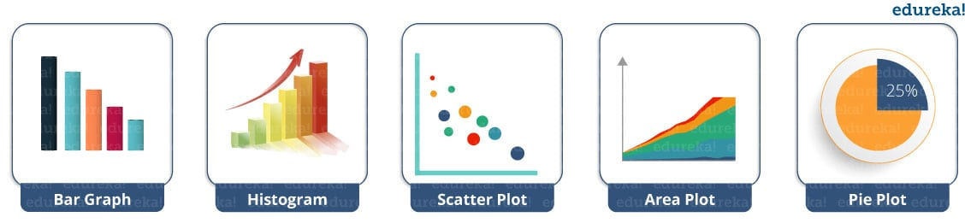
Matplotlib
Matplotlib is a comprehensive library for creating static, animated, and interactive visualizations in Python.

Slide 4
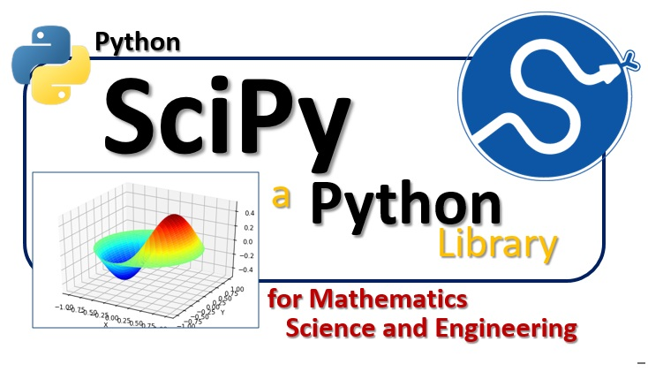
SciPy
SciPy in Python is an open-source library used for solving mathematical, scientific, engineering, and technical problems.
It allows users to manipulate the data and visualize the data using a wide range of high-level Python commands.
SciPy is built on the Python NumPy extension.

Slide 5
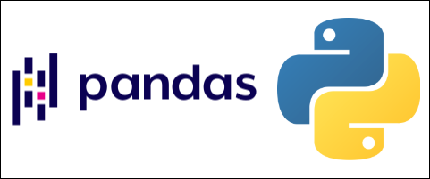
Pandas library
Python library for data analysis
It has an extremely active community of contributors
Pandas is built on top of two core Python libraries
matplotlib for data visualization
NumPy for mathematical operations.
Pandas acts as a wrapper over these libraries, allowing you to access many of matplotlib's and NumPy's methods with less code.

Slide 6
Before Pandas
Most analysts used Python for data munging and preparation, and then switched to a more domain specific language like R for the rest of their workflow
Pandas introduced objects for storing data that make analytical tasks easier:
Series, which have a list-like structure
DataFrames, which have a tabular structure.

Slide 7
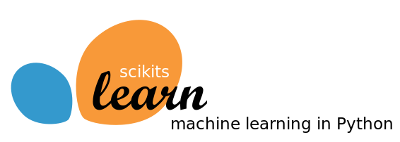
Scikit-learn
Scikit-learn is a free machine learning library for Python.
It features various algorithms like support vector machine, random forests, and k-nearest neighbours.
It supports:
Python numerical (NumPy)
Scientific libraries like SciPy.

